Slide 1
Challenge _________________
FIAP - Dow

Slide 2

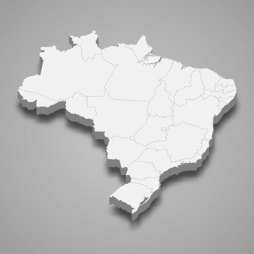


Data
More than 6,5 million people with visual impaiments.
528.624 are unable to see.
6.056.654 people have low vision or vision below normal.

Slide 3


Slide 4

Opportunities

Slide 5

Segregation

Slide 6
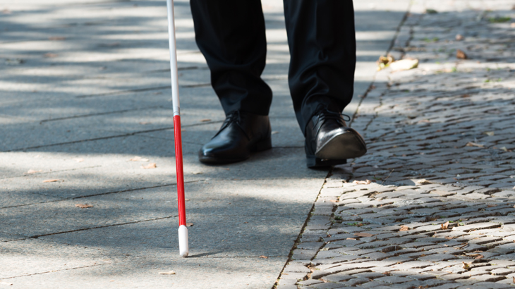
Locomotion

Slide 7


Slide 8

Objective
Easy Locomotion
Accessibility
Autonomy

Slide 9

Operation

Slide 10
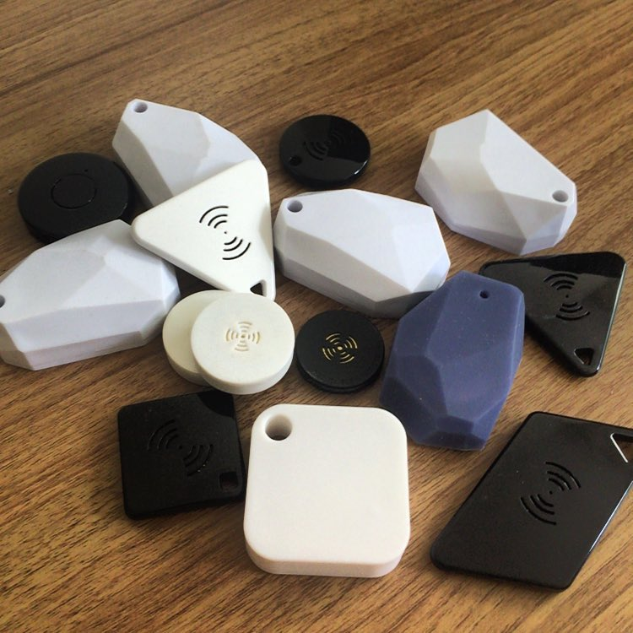
What is a Beacon?
IOT Device
Unique ID
BLE technology
“GPS”
Customizable

Slide 11
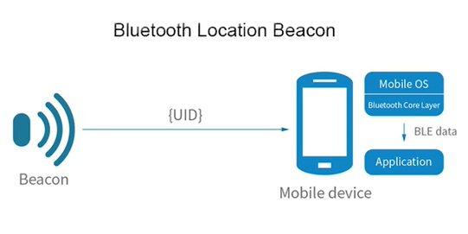

Slide 12

Infrastructure and Organization
Acquire Beacons
Devices Configuration
Basic training for employees

Slide 13

Benefits and Advantages
Low Cost
Practicality
Autonomy
Objectivity

Slide 14
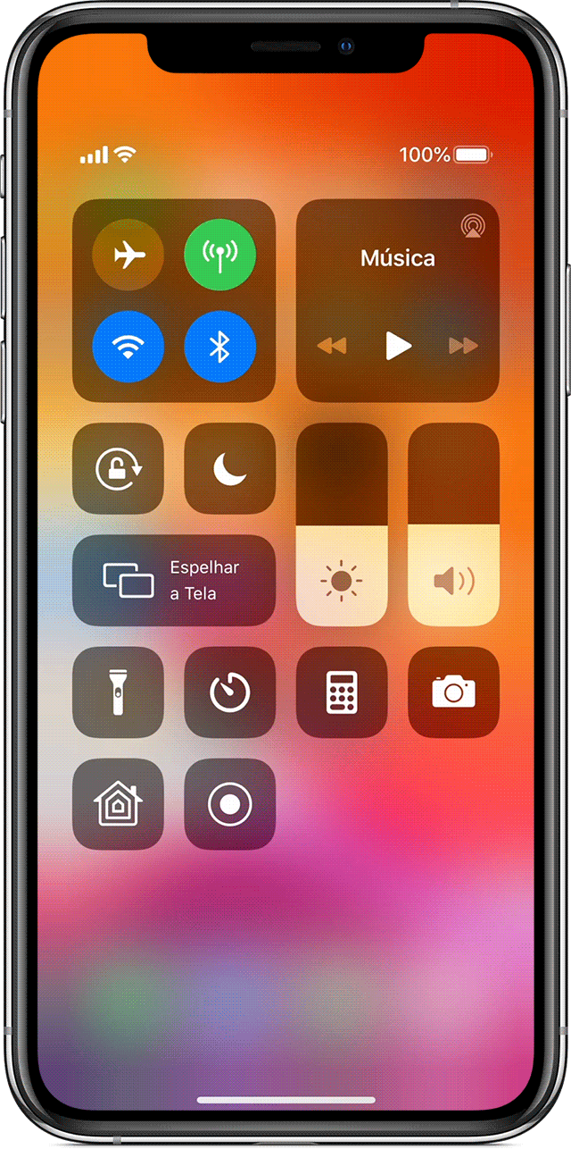


Slide 15



BeEyes

Slide 16



BeEyes

Slide 17



BeEyes

Slide 18





Settings
Speech Speed
Language
Partners
Contact
Administrator
BeEyes

Slide 19



Language
Português
English
Español
BeEyes

Slide 20


Speech Speed
50%
BeEyes

Slide 21


Contact
Suporte@BeEyes.com.br
+55 (DDD) 99999-9999
BeEyes

Slide 22



Administrator
Register Administrator
Register Location
BeEyes

Slide 23
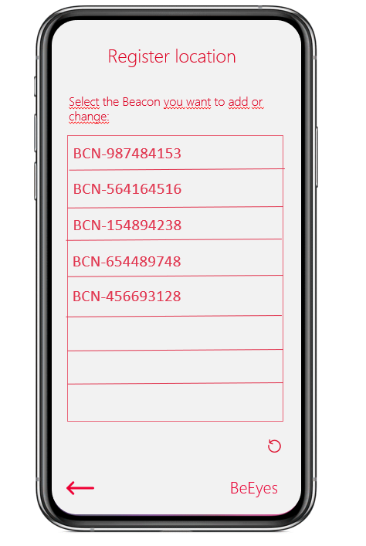

Slide 24

Beacon registered!
Register Location
Place Name:
REGISTER/CHANGE BEACON
BeEyes

Slide 25
Administrator
Register Administrator
Register Location
BeEyes

Slide 26
Access Invitation
Enter the email address of the person you
want to send the invitation to:
Confirm email address:
SUBMIT
BeEyes

Slide 27


Access Invitation
Email successfully sent
BeEyes

Slide 28
BeEyes

Slide 29


Free mode navegation in
progress
BeEyes

Slide 30
BeEyes

Slide 31

Select the available place you
want to go to
BeEyes

Slide 32
Starting navegation to the
selected location
BeEyes

Slide 33


Partners
BeEyes

Slide 34
Thanks!

Slide 35
